Slide 1
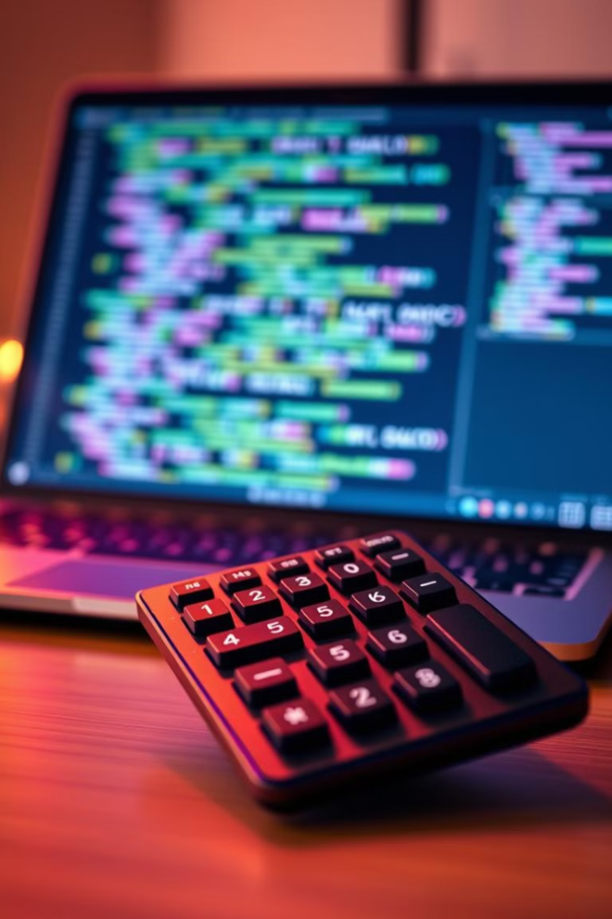
Project 1: Python GUI Calculator using Tkinter
NEXTHIKES IT SOLUTIONS
This calculator gui has been built using the Tkinter library in Python. It supports simple calculations and can display an error message if any.

Slide 2
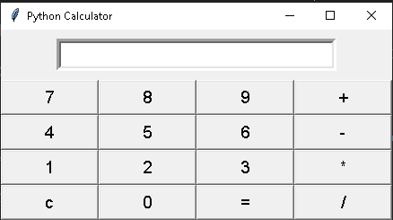
Calculator Overview/Features
+ Addition Adding two numbers
- Subtraction Subtracting two numbers
x Multiplication Multiplying two numbers
/ Division Dividing two numbers
c Clear Clear display content

Slide 3
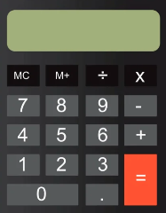
Designing the Interface: Layout and Widgets
A grid layout is used for the calculator. Widgets include buttons for numbers and operations. A text entry field will display the input and results. Design for usability.
Event Handling: Connecting Buttons to Actions
Each button needs to trigger an action. We'll use event handlers to connect buttons. For instance, clicking the "+" button calls the addition function. Update the display with the result.
Enhancements: Error Handling and Features
Implement error handling to catch invalid input. Add features such as decimal numbers. Also add a clear button. Improve the user experience.

Slide 4

Challenges Faced and Solutions
Learning and exploring a new python library (tkinter) using online referencecs.
Reducing the complexity and length of the code (using for loop, list and tuples).
Ensuring buttons are evenly spaced and properly aligned across different screen sizes.
Creating a gui with almost the same dimensions, spacing and layout as per the given assignment.

Slide 5
Reference Links
https://www.geeksforgeeks.org/python-gui-tkinter/
https://www.geeksforgeeks.org/python-simple-gui-calculator-using-tkinter/
https://docs.python.org/3/library/tkinter.html

Slide 6

Thank You
Thank you for your time and attention. I hope you have a wonderful day!

